Slide 1
Large-Scale CDN Measurement in China
114694

Slide 2
Content Delivery Network (CDN)
CP
(Content Provider)
CP
ISP
ISP
CDN
Users
Users
Advantage:
Lower latency (users and CPs are happy)
Lower traffic (ISPs are happy?)

Slide 3
Traditional Challenges for CDN
CP
ISP
Server deployment
Where? How many? Cost?
Content replication
Hit ratio: popular/stale content, mobility
Migration cost
Architecture and techniques
Deep into ISP, deploy in data centers
DNS, IP Anycast
Flat or multiple layers
Server assignment
Minimize latency for users
Load balancing
CDN
Users
Can we do better?

Slide 4
Networks are Changing (1/2)
Many players try to join and share the CDN market – CP, ISP, Cloud Owner
What’s the advantage and disadvantage?
CP: knows users’ demands
ISP: knows the network topology and users’ locations, but may cover only small region
Cloud Owner: has the infrastructure ready, but may not be closer to users
Expectation from the measurement?
Observe the strategies and architecture adopted by different players
Confirm/observe the advantage and disadvantage
Implication
Business Model for cooperation among players
CDN-ISP
CDN-CDN
CP-CDNs (CP may use multiple CDNs)

Slide 5
Networks are Changing (2/2)
Application-specific CDNs
Applications are building their CDNs
Questions: do we need different CDN architecture for different applications?
Is Youku’s CDN better than Ali’s CDN for streaming?
Expectation from the measurement
Different CDN providers may be good at serving different types of applications
video on demand, live videos, music, online gaming, static web sites, …
Identify the important factors for different types of applications
delay, jitter, availability, …
Implication
Develop design principles for different applications
Provide incentive for moving toward ADN

Slide 6
This Measurement
Goal:
Understand the status of current CDN ecosystems
Players from CP, ISP, CDN, Cloud owners
Various types of applications
Build a measurement platform
Provide insight into the design space for our theory work
Contribution:
Measurement methodology
Challenges due to the network censorship in China
Observations and implications

Slide 7
To Start with, Answer the Questions:
How many CDN and DNS servers are there?
Where are they deployed?
What’s the performance?
Dimensions: space, time, ISP
Metrics: latency, jitter, availability, …

Slide 8
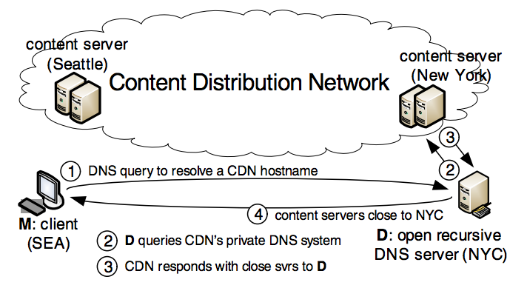
Measurement Methodology

Slide 9
Measurement Challenges
How to get open recursive DNS servers?
In other works which conducted mainly in US, there are a lot of open DNS servers provided by Google, Yahoo, Cisco, and etc.
Not available in China because of the Internet censorship
Solution:
Misconfigured Authoritative DNS
Authoritative DNS servers should only serve requests for corresponding domains
Some of them are misconfigured and open for all queries

Slide 10
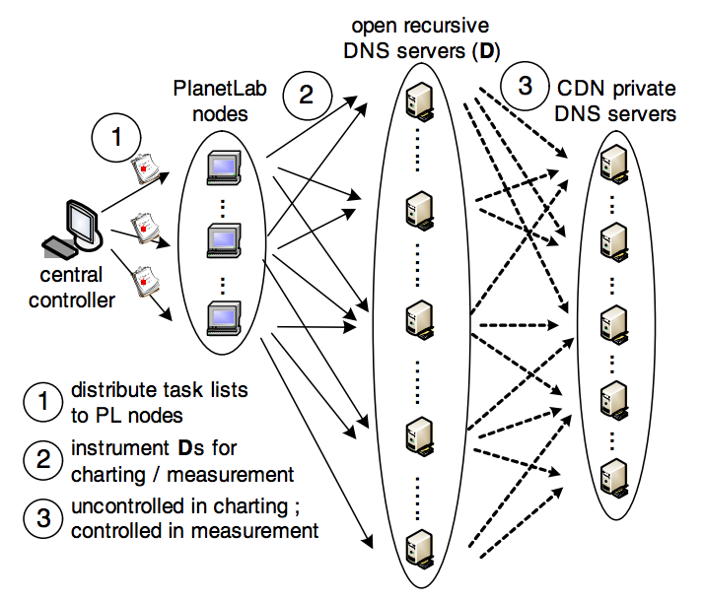
Measurement Methodology (Cont’d)
Crawl web site hostnames china.msn.com
Query CNAMEs of hostnames china.msn.chinacache.net
Query Authoritative DNS of hostnames ns1.chinacache.com
Check if DNS is open to all queries
Send DNS queries of CNAMEs to open DNS to get IPs
Query IP Geolocation Database to get geolocation/AS/ISP of IPs

Slide 11
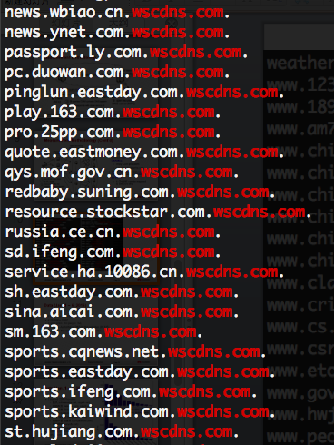
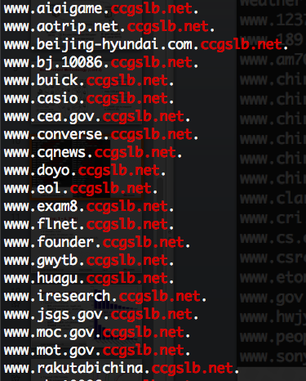
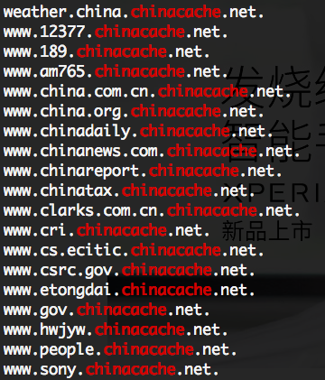
CNAME
Canonical Name record (CNAME)
A type of resource record in DNS
Specify that a domain name is an alias for another domain
Commonly used by CDN to redirect traffic to their servers

Slide 12
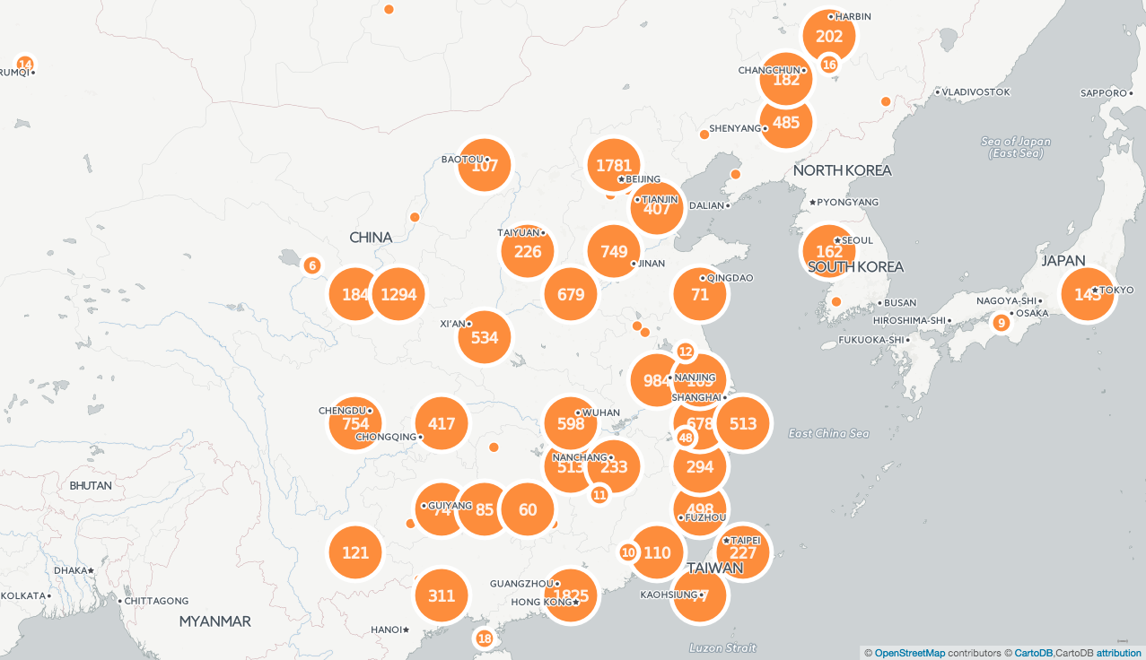
Dataset
Start from Jan. 1, 2016
# of web sites: 2,853,240
# of CNAMEs: 124,193
# of Authoritative DNS: 2,377,035
# of open DNS: 6,250
https://yichao0319.cartodb.com/viz/2ba1c7d6-bf52-11e5-bce8-0e5db1731f59/public_map

Slide 13
Misconfigured DNS Servers
Distributed across 96 cities in China
City | count | Ratio
Beijing | 1354 | 36.585%
Hangzhou | 266 | 7.187%
Changsha | 235 | 6.350%
Guangzhou | 220 | 5.944%
unknown | 125 | 3.377%
Shanghai | 109 | 2.945%
Wuhan | 109 | 2.945%
Fuzhou | 105 | 2.837%
Jinan | 94 | 2.540%
Nanjing | 93 | 2.513%

Slide 14
Misconfigured DNS Servers
AS | count | Ratio | Name | Owner
AS4808 | 1050 | 28.4% | CHINA169-Backbone | CNCGROUP IP network China169 Beijing Province Network
AS4134 | 768 | 20.8% | CHINANET-BACKBONE | No.31,Jin-rong Street
AS4837 | 514 | 13.9% | CHINA169-Backbone | CNCGROUP China169 Backbone
AS37963 | 203 | 5.5% | CNNIC-ALIBABA-CN-NET-AP | Hangzhou Alibaba Advertising Co.,Ltd.
AS4538 | 190 | 5.1% | ERX-CERNET-BKB | China Education and Research Network Center
AS63835 | 150 | 4.1% | CT-HuNan-Changsha-IDC | No.293,Wanbao Avenue
AS4847 | 104 | 2.8% | CNIX-AP | China Telecom (Group)
AS4812 | 90 | 2.4% | CHINANET-SH-AP | China Networks Inter-Exchange
AS9308 | 78 | 2.1% | CHINA-ABITCOOL | Abitcool(China) Inc.
AS23724 | 53 | 1.4% | CHINANET-IDC-BJ-AP | IDC, China Telecommunications Corporation

Slide 15
Misconfigured DNS Servers
Authority Domain | count | Ratio
dm5.com | 8 | 0.022%
jinlist.com | 6 | 0.016%
baseballamerica.com | 6 | 0.016%
discoverlosangeles.com | 6 | 0.016%
onrad.io | 6 | 0.016%
ebook.ilfattoquotidiano.it | 6 | 0.016%
miradining.com | 6 | 0.016%
recodereprints.com | 6 | 0.016%
www.itgovernance.co.uk | 6 | 0.016%
www.washingtonpostreprints.com | 6 | 0.016%

Slide 16
CDN Providers in China
Targeted CDN Providers
藍汛 (chinacache.net, ccgslb.net)
网宿科技 (wscdns.com, cdn20.com)
百度云加速 (yunjiasu-cdn.net)
阿里云 (aliyun.com)
騰訊云平台 (cdntip.com)
優酷 (youku.com)
帝聯科技 (fastcdn.com)
快网 (cloudcdn.net)
知道宇雲 加速乐 (cdn.jiashule.com)
雲端網絡 (verycdn.net)
CloudFlare (cloudflare.com)
网宿 and 藍汛 account for 43% and 20% of total CDN servers in China, respectively.

Slide 17
CDN Providers in China
Targeted CDN Providers
藍汛 (chinacache.net, ccgslb.net)
网宿科技 (wscdns.com, cdn20.com)
百度云加速 (yunjiasu-cdn.net)
阿里云 (aliyun.com)
騰訊云平台 (cdntip.com)
優酷 (youku.com)
帝聯科技 (fastcdn.com)
快网 (cloudcdn.net)
知道宇雲 加速乐 (cdn.jiashule.com)
雲端網絡 (verycdn.net)
CloudFlare (cloudflare.com)
Most CDN providers have some content be widely distributed and some stored in a few servers (hierarchical structure)
雲端網絡 and CCTV store contents in most of their servers (flat structure)
Notes:
VeryCDN distributes content to all nodes.
While most CDN bias – pricing?

Slide 18
Location – Country
Country | wscdns | cdn20 | chinacache | ccgslb | yunjiasu-cdn | cctvcdn | aliyun | cdntip | youku | cloudflare
CN | 84.3% | 84.4% | 84.3% | 92.7% | 39.7% | 80.8% | 72.7% | 97.8% | 91.3% | 0.2%
US | 2.4% | 2.7% | 10.8% | 5.2% | 50.0% | 3.7% | 3.5% | 0.5% | 4.2% | 86.1%
CH | 3.8% | 3.9% | 2.6% | 0.7% | 7.5% | 3.2% | 8.3% | 1.2% | 2.8% | 4.4%
TW | 4.5% | 4.0% | 0.3% | 0.4% | 0.4% | 7.7% | 0.4% | 0.1% | 0.2% | 0.2%
JP | 1.9% | 1.6% | 0.0% | 0.0% | 0.0% | 0.5% | 0.0% | 0.0% | 0.0% | 0.0%
IE | 0.5% | 0.6% | 0.4% | 0.4% | 0.9% | 0.7% | 0.9% | 0.2% | 0.6% | 0.7%
MY | 0.7% | 1.2% | 0.4% | 0.1% | 0.0% | 1.7% | 0.0% | 0.0% | 0.0% | 0.0%
HK | 0.2% | 0.2% | 0.0% | 0.0% | 0.3% | 0.2% | 12.9% | 0.0% | 0.0% | 0.0%
SG | 0.2% | 0.2% | 0.1% | 0.1% | 0.2% | 0.2% | 0.2% | 0.0% | 0.1% | 1.2%
KR | 0.3% | 0.3% | 0.0% | 0.0% | 0.1% | 0.5% | 0.0% | 0.0% | 0.0% | 0.0%
All of them are mostly located in China, except 百度云加速 and CloudFlare
Notes:
MO: Macao
MY: Malaysia

Slide 19
Location – Cities in China
City | wscdns | cdn20 | chinacache | ccgslb | yunjiasu-cdn | cctvcdn | aliyun | cdntip | youku | cloudflare
Beijing | 8.4% | 6.4% | 18.9% | 15.0% | 14.7% | 24.3% | 10.4% | 12.6% | 61.3% | 0.0%
Guangzhou | 15.2% | 15.3% | 6.0% | 6.3% | 15.9% | 11.6% | 0.0% | 8.8% | 0.8% | 0.0%
Jinan | 7.3% | 6.7% | 13.3% | 14.2% | 2.0% | 5.6% | 0.1% | 4.2% | 1.3% | 28.2%
Hebei | 11.1% | 9.7% | 8.8% | 8.2% | 3.2% | 4.5% | 0.0% | 2.2% | 2.5% | 0.0%
Shenyang | 1.8% | 1.7% | 7.6% | 8.5% | 1.3% | 1.0% | 0.0% | 17.7% | 11.2% | 0.0%
unknown | 7.9% | 7.9% | 4.2% | 4.5% | 0.2% | 14.4% | 0.0% | 1.3% | 3.9% | 0.0%
Taiyuan | 4.7% | 7.0% | 7.6% | 8.3% | 0.0% | 2.9% | 0.0% | 0.1% | 4.4% | 0.0%
Nanjing | 3.8% | 4.8% | 4.7% | 4.5% | 0.6% | 4.9% | 0.0% | 5.7% | 1.9% | 5.7%
Zhengzhou | 2.8% | 2.6% | 0.8% | 1.1% | 2.7% | 1.4% | 0.0% | 24.3% | 0.0% | 0.0%
Hangzhou | 1.5% | 1.2% | 4.9% | 5.5% | 5.4% | 2.9% | 87.8% | 3.1% | 0.5% | 5.7%
北京 and 廣州 account for 12% and 11% CDN servers
Notes:
MO: Macao
MY: Malaysia

Slide 20
Location – ISPs
AS | Owner | wscdns | cdn20 | china cache | ccgslb | yunjiasu-cdn | cctvcdn | aliyun | cdntip | youku | cloudflare
AS4837 | China169 Backbone | 39.5% | 39.3% | 69.1% | 74.1% | 10.8% | 28.4% | 1.2% | 72.2% | 27.1% | 34.0%
AS4134 | No.31,Jin-rong Street | 25.0% | 26.1% | 6.4% | 5.6% | 9.6% | 22.6% | 1.3% | 3.6% | 5.3% | 60.3%
AS4808 | China169 Beijing Province Network | 6.9% | 4.9% | 6.7% | 4.6% | 1.2% | 20.2% | 0.3% | 9.5% | 61.0% | 0.0%
AS58543 | Guangdong | 7.2% | 7.6% | 1.0% | 0.7% | 15.9% | 5.0% | 0.0% | 2.6% | 0.0% | 0.0%
AS54994 | QUANTIL, INC | 9.0% | 6.9% | 0.0% | 0.0% | 0.0% | 6.4% | 0.0% | 0.0% | 0.0% | 0.0%
AS17816 | China Unicom IP network China169 Guangdong province | 0.2% | 0.3% | 4.9% | 5.5% | 0.0% | 0.4% | 0.0% | 2.7% | 0.8% | 0.0%
AS23650 | China Telecom (Group) | 2.8% | 3.0% | 1.0% | 0.9% | 0.3% | 2.5% | 0.0% | 0.9% | 1.4% | 5.7%
AS4538 | CHINANET jiangsu province backbone | 2.0% | 1.9% | 0.7% | 0.8% | 0.0% | 3.5% | 0.0% | 0.0% | 0.3% | 0.0%
AS4835 | China Education and Research Network Center | 0.0% | 0.0% | 0.5% | 0.5% | 36.4% | 0.0% | 0.0% | 0.3% | 0.4% | 0.0%
AS133119 | China Unicom | 0.0% | 0.0% | 0.0% | 0.0% | 9.8% | 0.0% | 10.1% | 0.0% | 0.0% | 0.0%
AS37963 | Hangzhou Alibaba Advertising Co.,Ltd. | 0.0% | 0.0% | 0.0% | 0.0% | 3.4% | 0.0% | 87.0% | 0.0% | 0.0% | 0.0%

Slide 21
Distance Between DNS and Assigned CDN Servers
CDN selects a server which is close to the DNS server

Slide 22
Distance Between DNS and Assigned CDN Servers
Less than 40% of assigned servers are within 100km to the users.
The issue is observed in other studies on US CDNs, but not as bad as this.
阿里雲 (Aliyun) is far away from users – they may use their datacenter
网宿 (wscdns, cdn20) is close to users but 藍汛 (chinacache, ccgslb) is not. This may imply two largest CDN providers in China adopt different architectures.

Slide 23
Cooperation Among Players
Same IPs appear in multiple CND
For example: wsall.haikou.gov.cn.cdn20.com. ➔ 54.247.165.51 m.chinanews.chinacache.net. ➔ 54.247.165.51
Possible reasons
[CDN-CDN] CDN provider A may rent another CDN provider B
To serve her users out of China
We observe many common IPs belong to Amazon or Akamai
A doesn’t have her own infrastructure
優酷 have most of IPs belong to 藍汛
CCTV have most of IPs belong to 网宿
[CDN-ISP] ISP requests CDN provider A and B to rent ISP’s server
We observe many common IPs belongs to China Mobile communications

Slide 24
Same IPs Appear in Multiple CDN Providers
ratio of dup IPs | wscdns | cdn20 | china cache | ccgslb | Yunjiasu -cdn | cctvcdn | aliyun | cdntip | youku | cloud flare
wscdns |  | 62.6% | 1.3% | 4.2% | 0.1% | 6.0% | 0.1% | 0.1% | 0.1% | 0.1%
cdn20 | 72.6% |  | 1.6% | 4.1% | 0.2% | 6.9% | 0.2% | 0.2% | 0.1% | 0.2%
china cache | 4.2% | 4.6% |  | 71.8% | 0.5% | 0.7% | 0.5% | 0.5% | 7.6% | 0.5%
ccgslb | 7.6% | 6.3% | 37.9% |  | 0.2% | 0.2% | 0.2% | 0.2% | 4.2% | 0.2%
Yunjiasu -cdn | 0.4% | 0.4% | 0.4% | 0.4% |  | 0.4% | 0.4% | 0.4% | 0.3% | 0.4%
cctvcdn | 63.0% | 62.4% | 2.0% | 1.5% | 1.5% |  | 1.5% | 1.5% | 1.2% | 1.5%
aliyun | 5.2% | 5.2% | 5.2% | 5.2% | 5.2% | 5.2% |  | 5.2% | 4.2% | 5.2%
cdntip | 1.8% | 1.8% | 1.8% | 1.8% | 1.8% | 1.8% | 1.8% |  | 1.4% | 1.8%
youku | 4.6% | 4.6% | 93.1% | 97.7% | 4.6% | 4.6% | 4.6% | 4.6% |  | 4.6%
cloud flare | 100.0% | 100.0% | 100.0% | 100.0% | 100.0% | 100.0% | 100.0% | 100.0% | 80.0%

Slide 25
Next Steps
How many CDN and DNS servers are there?
Where are they deployed?
What’s the performance?
Dimensions: space, time, ISP
Metrics: latency, jitter, availability, …
Challenges
There are only 14 PlanetLab nodes located in 5 cities in China
Lack of resources to perform measurement through different ISPs

Slide 26
Backup

Slide 27
Insights from Tian’s review
Business and regulatory environment in China
Novelty on measurement methodology

Slide 28
Anycast
A routing strategy:
Same IP address is announced from many locations throughout the world
BGP routes clients to one front-end location based on BGP’s notion of best path
Pros
Simplicity
defers client redirection to Internet routing
Each client redirection is handled independently
Compared with DNS-based CDN, Anycast avoid the LDNS problem
Cons
Unaware of network performance
Unaware of server load
Many CDN providers use Anycast
Microsoft, Cloudflare, CacheFly, and Edgecast

